Slide 1
Pixel
BUSINESS PLAN
GROW
Here is where our presentation begins

Slide 2
01
Introduction
BUSINESS OVERVIEW
02
03
04
05
Table of contents
BMC
Financial plan
Marketing plan

Slide 3
PIXEL GROW VALUE
Pixel Grow is a creative software company focused on turning ideas into smart digital solutions.
We design high-quality websites, create distinctive logos, and develop custom mobile and desktop applications that help businesses grow.
We also provide server security services, helping companies protect their internal systems and data from digital threats.
At Pixel Grow, we combine creativity and technology to build secure, effective, and modern digital experiences.

Slide 4
introduction
Pixel Grow is a creative software company focused on turning ideas into smart digital solutions.
We design high-quality websites, create distinctive logos, and develop custom mobile and desktop applications that help businesses grow.
We also provide server security services, helping companies protect their internal systems and data from digital threats.
At Pixel Grow, we combine creativity and technology to build secure, effective, and modern digital experiences.

Slide 5
OUR SERVICES
Web designing
App development
Logo design
Secure apps and sites
courses
We provide a professional designers to design your web site.
We can develop a apps to show your services
We design a professional logos to express your identity
We provide a security system on a high level
We make courses to teach a important skills
career life

Slide 6
02
BUSINESS
OVERVIEW
Pixel Grow is a digital solutions company that specializes in designing websites, logos, and custom applications tailored to business needs. We also provide server security services to help companies protect their internal systems and grow

Slide 7
Key partners AND KEY ACTIVITIES
Key partners
KEY ACTIVITIES
03
Bmc_items
-Trainers
-designers
-programmers
-sell design
-design websites
-provide courses
Notes:
CEO

Slide 8
Value proposition AND Key resources
Key resources
Value proposition
-A lot of courses
-A lot of teachers
- Fast
- accurate designs
- save effort
- courses

Slide 9
customer relationship AND channels
Customer relationships
channels
-save effort
-low cost
-fast finishing
-our website
-our APP
-QR code
-our E mail
-our customer service
Notes:
CS and CMO

Slide 10
Cost structure AND REVENUE STREAMS
Cost structure
Revenue streams
-employees salary
-computer devices
-others
-sell designs
- our courses
- services for other companies
- courses
Notes:
Youssef taha { CFO }

Slide 11
CUSTOMER SEGMENTS
Customer segments
-students
-designers
-personal usage
-start up companies

Slide 12


THEM VS. US
THEM
US
If you want to do any software services, you need to implement each service separately at a high cost.
We provide you with all software services together in one place and at a cheap price compared to others.

Slide 13
04
Financial
plan
Financial plan for PixelGrow company

Slide 14
Our company Budget
Team gender
$2.000.000
17%
83%
Our company budget
Company value
AGE
Education
design
14
16
web

Slide 15
COMPETITION ANALYSIS
 | description
- nobleprog | Expensive, focusing only on technical areas, requiring a significant time commitment.
- theschoolofit | .
- udacity | 1. High cost:2. Lack of official academic accreditation:3. Inconsistency in content quality or support:
CompetitorS
The direct training model may not be suitable for everyone. Certifications may not be accredited.

Slide 16
ASSETS
LIABILITIES
BALANCE SHEET
-Our courses
- Our device
-Our Logo
-employees salary
-subscriptions
- Rent

Slide 17
Cost structure

Slide 18
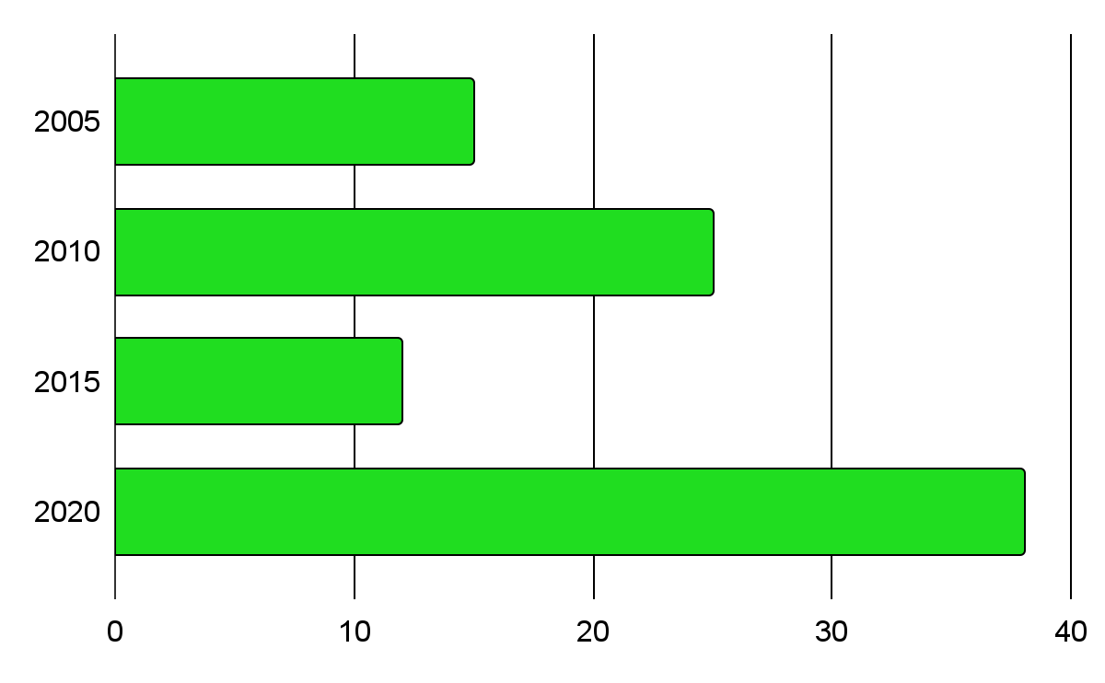
Cost structure
salaries
Computers
Salaries of employees
Computers of our offline courses
Cost of Rent
subscriptions
Rent of the place where we do our offline courses
Subscriptions of apps that we use in our courses

Slide 19
Item | Cost of 1 item | Number of items
UI Designers | 15000 | 2
UX Designers | 15000 | 2
Computer devices | 13000 | 24
Office boys | 4000 | 2
programers | 20000 | 4
Marketing [posters,Ads] | 50000 | 1
Cyber security | 17000 | 3
Rent | 15000 | 1
Air conditioning | 30000 | 4
TOTAL | 696000

Slide 20
Our revenue streams

Slide 21
Service | Cost of Service | Basic | pro | Premium
Design logos | 10,000 | 17,000 | 20,000 | 30.000
Website design | 10,000 | 130,000 | 170,000 | 200,000
Programming apps | 130,000 | 240,000 | 270,000 | 370,000
courses
programing | 20,000 | 22,000 | 25,000 | 30,000
Graphic design | 15,000 | 15,000 | 20,000 | 25,000
Soft skills | 9,000 | 10,000 | 15,000 | 20,000

Slide 22
profit
Service | Cost of Service | Basic | pro | Premium
Design logos | 10,000 | 7,000 | 10,000 | 20.000
Website design | 10,000 | 120,000 | 160,000 | 190,000
Programming apps | 130,000 | 370,000 | 400,000 | 500,000
courses
programing | 20,000 | 2,000 | 25,000 | 30,000
Graphic design | 15,000 | 15,000 | 5000 | 10,000
Soft skills | 9,000 | 1000 | 6,000 | 10,000

Slide 23
NET PROFIT
Item | Amount[EGP]
Total services profit | 1,387,000
Total courses profit | 51,000
Total Gross profit | 1,483,000
Taxes [10%] | 143,000
Total expenses | 696,000
Net Profit | 598,000

Slide 24
Difference between EAch version
Basic
Pro
Premium
-20 sessions
-No Live sessions
-AI corrected HomeWork
-Limited Events
-Can’t choose your Teacher
-Junior certification from our academy
-30 sessions
- 3 live sessions
- Homework corrected by an expert
- More Events
- Can Choose your Teacher from few options
-Senior certification from our academy
-50 sessions
-6 live sessions
- Homework corrected by
Expert
-we call you periodically and check that you understand
-Expert certification from our academy

Slide 25
Channels AND
05
MARKETING PLAN
You can enter a subtitle here if you need it

Slide 26
Customers we target
Young adults
(18-25) . primary target audience
. Active on TikTok, Instagram, and Facebook

Slide 27
Customers we target
teenagers
Adults
(13-17) . limited audience
. Active on TikTok and Instagram
(26-40) .secondary target audience
. Active on linkedin and facebook

Slide 28



Our channels
CHANNEL 1
CHANNEL 3
CHANNEL 4
CHANNEL 5
CHANNEL 2
Contact us through our social media accounts
Scanning our Qr_code
reach our customer service
our website
Contact us through
Phone number
contact us through our email

Slide 29
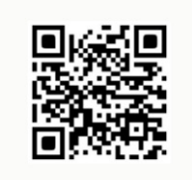
Our channels
Channel 1
Channel 2
Instagram account : https://www.instagram.com/pixel_grow?igsh=MWU3Nm0xbzNkNXVnYQ==
Tik tok account:
https://www.tiktok.com/@pixel.grow0?_t=ZS-8y4hd3HxIuX&_r=1
Facebook account :https://www.facebook.com/profile.php?id=61578711020852

Slide 30
Our channels
Channel 5
Channel 4
Channel 3
The phone number : 01144260456
Link of website :
The email :
2msf1952010@gmail.com

Slide 31
04
MANAGEMENT
PLAN
You can enter a subtitle here if you need it

Slide 32



OUR TEAM
Ceo
Cfo
Cmo
Mohamed Ahmed Gamal
Youssef Taha Saad
Retal Ahmed

Slide 33



OUR TEAM
cs
scm
Hr
Ziad Ali Koriem
Youssef Sayed Qorany
Mahmoud Ahmed

Slide 34
OPERATING
05
PLAN
You can enter a subtitle here if you need it

Slide 35
OUR PROCESS
DAY 1
Choose the Name
DAY 3
Rechoose the name
DAY 5
Choose the idea
DAY 2
Choose the design
DAY 4
Make presentation

Slide 36
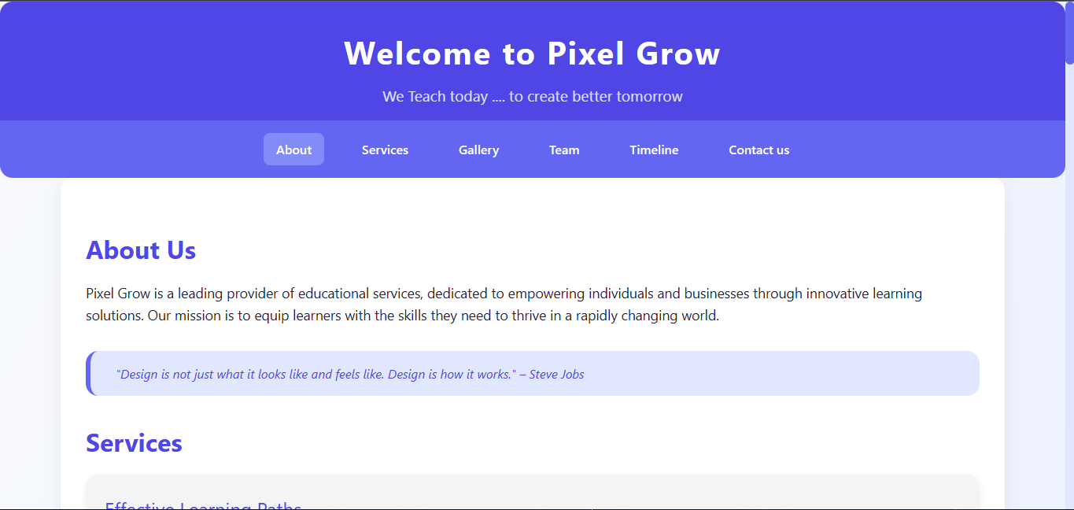
OUR WEBSITE
You can replace the image on the screen with your own work. Just right-click on it and select “Replace image”

Slide 37
THANKS!
Do you have any questions?
youremail@freepik.com
+91 620 421 838
yourcompany.com
Please keep this slide for attribution

